Slide 1
Semantic Database
Concept
Prototype
Implementation

Slide 2
Concept
Current database technologies
Relational (RDBMS)
NoSQL (document)
Graph (node-edge)

Slide 3
Relational Databases
Tables
Container for loosely associated fields
Fields
Typed data values
Foreign Keys
Loose associations between tables
1:1, 1:n, m:n

Slide 4
NoSQL Databases
Document-based
Key-value pairs (JSON)
Type-less
Unstructured associations between K-V pairs
Each relationship de-reference requires a round trip to the server (no joins)

Slide 5
Graph Database
A node is a concrete instance
A node can have attributes
Nodes are associated with other nodes (unidirectional, bidirectional) through “edges”
Edges can have attributes
Still under consideration as an underlying architecture

Slide 6
Semantic Database What Is This?
First, we need to take a step back.
What is “Semantics?”

Slide 7
Semantics The branch of linguistics and logic concerned with meaning
Formal Semantics
Logical aspects of meaning:
Sense
Reference
Implication
Logical form
Lexical Semantics
Word meanings
Word relations
Conceptual Semantics
Cognitive structure of meaning

Slide 8
Semantics
The study of meaning
Focuses on relationship between:
Signifiers: words, phrases, signs and symbols
Denotation: what they stand for
“No word has a value that can be identified independently of what else is in its vicinity.” (de Saussure, Ferdinand, 1916, The Course of General Linguistics)

Slide 9
Semantic Database (Take Two)
Schema
Describes denotations (concepts?)
Describes relationships between denotations
Relationship -> Structure -> Hierarchy -> Graph
Associates signifiers (values) to denotations
Structure resolves to concrete properties to which instance values can be associated
Implemented as language/database native types
However, in a semantic database, the structure is instantiated for each instance.

Slide 10
Relational Database
Defines a “structure”, for example:
Table: RSS_Feed_Item
Fields:
Name : string
Title : string
URL : string
Note how the field names are mostly high level abstractions
“select URL from RSS_Feed_Item”
Returns string values in all rows
The structure (semantic context) is completely lost

Slide 11
Semantic Database
Defines Structures:
RSS_Feed_Item
RSS_Feed_Name
Text
Value : string
RSS_Feed_Title
Title
Text
Value: String
RSS_Feed_URL
URL
Value : String
“select URL from RSS Feed Item”
Returns the structure and the value for each row:
RSS_Feed_Item.RSS_Feed_URL.URL.Value = [value]
“Every word has a value that is identified with what else is in its vicinity.”

Slide 12
Semantic Database
Queries can be made at any level in the structure, however this incrementally loses meaning:
“select URL from RSS_Feed_Url”
Some contextual loss
URL is no longer identified as being an RSS Feed URL
Returns “Url.Value” structure-values
“select Value from URL”
Complete contextual loss
Would return a collection of strings
This is the equivalent of the RDBMS query:
“select URL from RSS_Feed_Item”
In a semantic database, this query is actually not possible!

Slide 13
However!
A semantic database can be built on top of an RDBMS.
We can leverage:
foreign key constraints
server-side joins
unique key constraints
Unique key indexing
NoSQL does not offer any of these benefits

Slide 14
What Does Semantic + RDBMS Look Like?
Tables represent structure
Foreign keys describe sub-structures
Joins are used to join together structures
All-null native types takes on a specific meaning:
There is no structure instance

Slide 15
RDBMS vs. Semantic Database
RDBMS:
Relationships are driven by:
Cardinality
Normalization rules
“Logical” decoupling of field associations
The result is associations that not semantic but rather structural, leading to complex model diagrams
Relationships are (ideally) restricted to established foreign keys
Semantic Database:
Relationships are driven by:
The semantic structure itself
The result is semantic associations that are emergent as new semantic structures are created

Slide 16
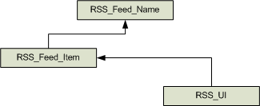
Example: RDBMS
RSS_Feed_Name
Name : text
RSS_Feed_Item
Title : text
Description : text
PubDate : date
Url : text
FK_RSS_Feed_Name
RSS_UI
FK_RSS_Feed_Item
Displayed
Visited

Slide 17
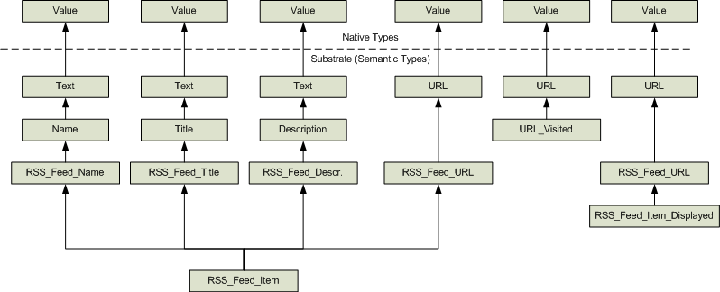
Unfolded Semantic Structure
This looks horribly complex but it’s actually a simple tree structure

Slide 18
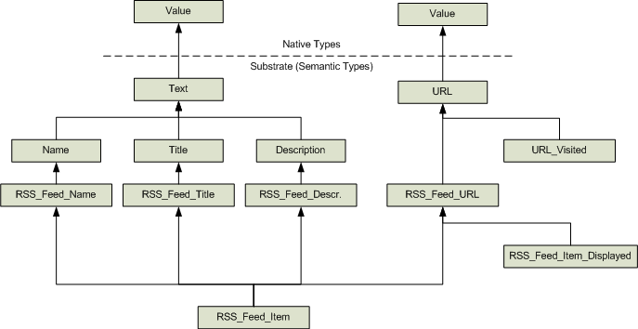
Hierarchical View

Slide 19
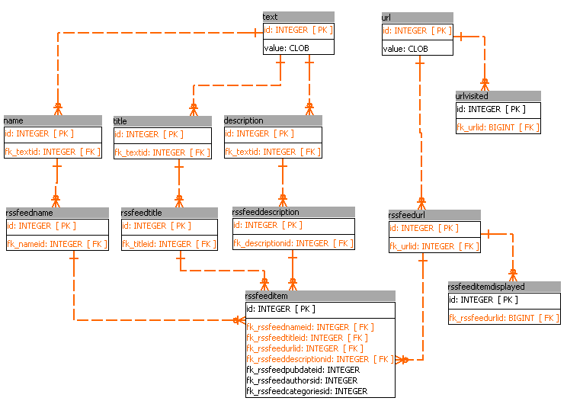
Semantic Database Schema in an RDBMS

Slide 20
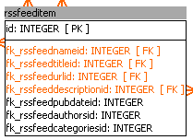

Things to Notice
The “deepest” semantic types are almost always composed just of foreign keys.
Tables with native types are very “thin”, having very few fields.

Slide 21
So What?
We can now ask:
What are all the URL’s recorded in the system?
What are the URL’s we have visited

